Slide 1
0D and 1D Materials Databases

Slide 2
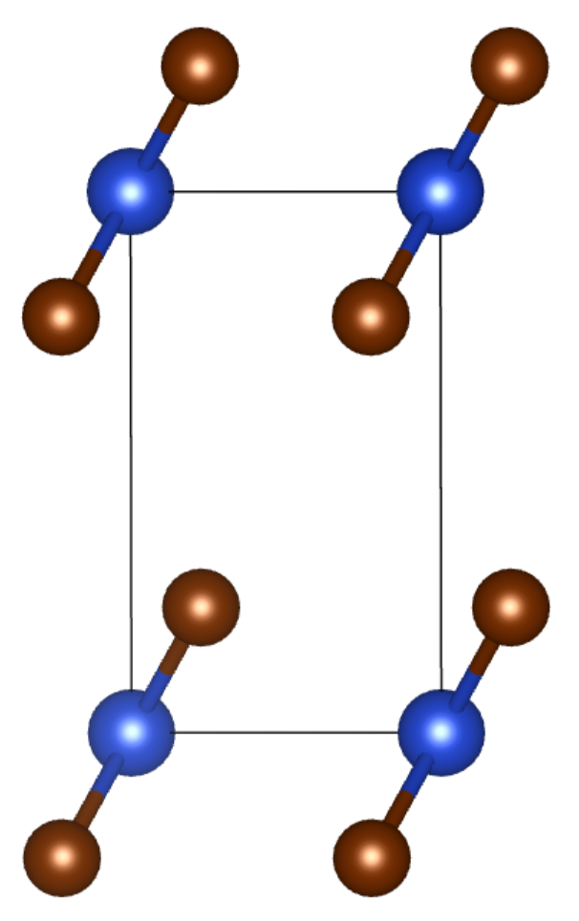
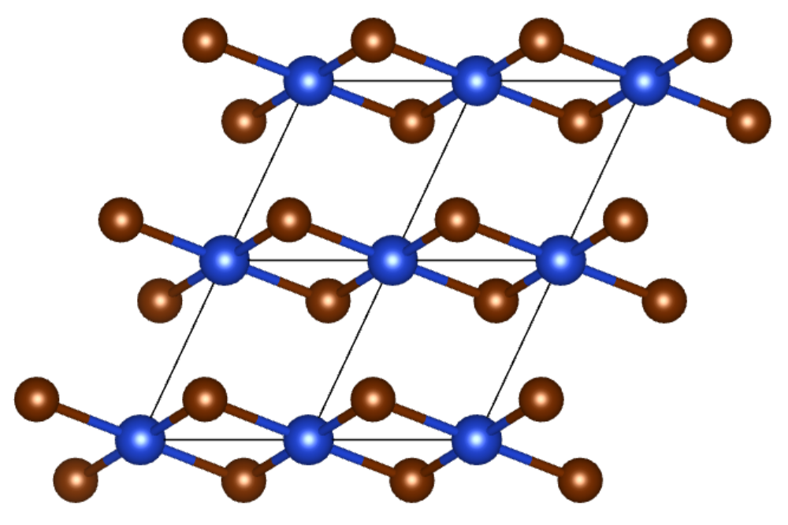
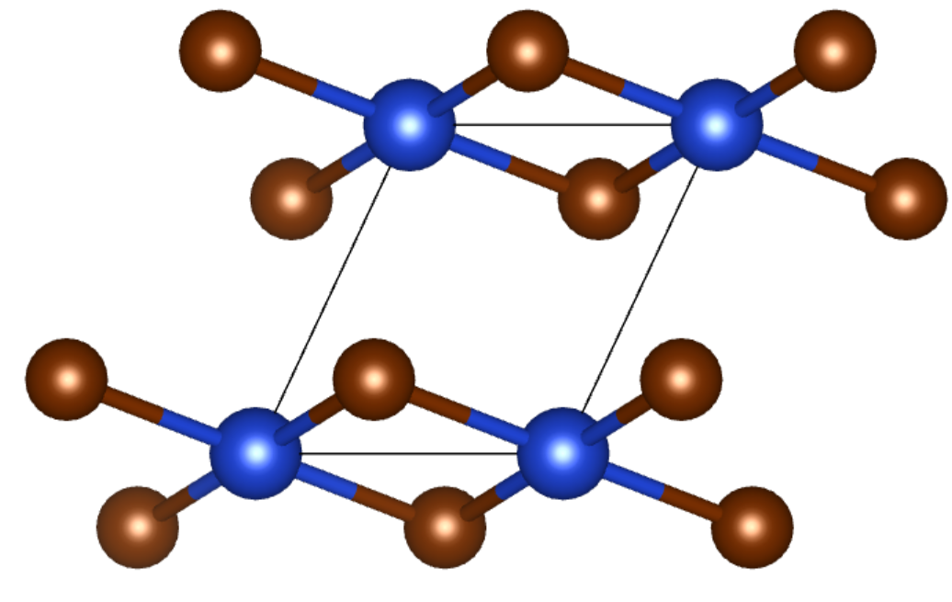
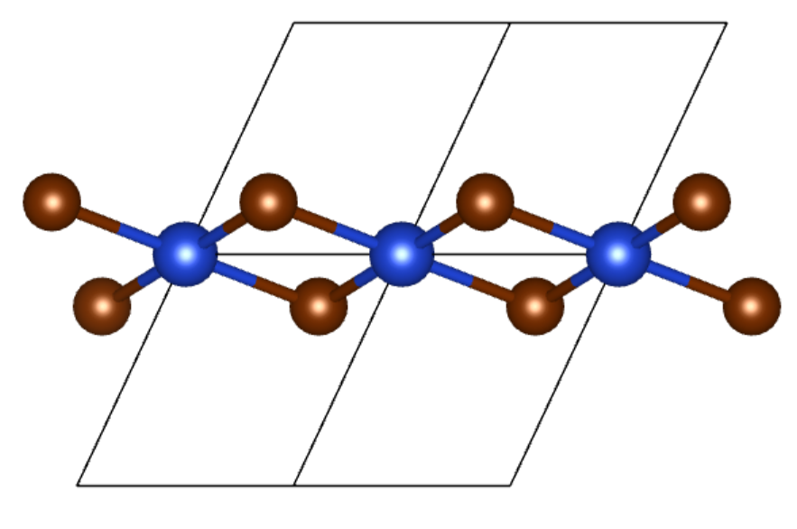
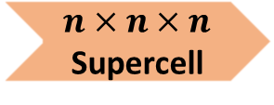
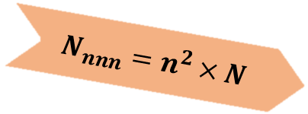
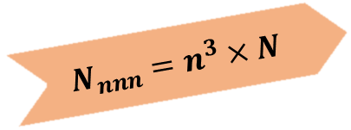


Topology-based identification of 0D and 1D Materials
After pre-screening | # of materials
0D materials | 3458
1D materials | 1091
$$N_{nnn}=n^{3}×N$$
0D
Count Clusters ($N$)
$n×n×n$ Supercell
Count Clusters ($N_{nnn}$)
$$N_{nnn}=n^{2}×N$$
1D
Br
Cu
On top of Zhou Jun’s Nature Sci. Data.
Notes:
Bottom: mp-23219 from new Materials Project

Slide 3
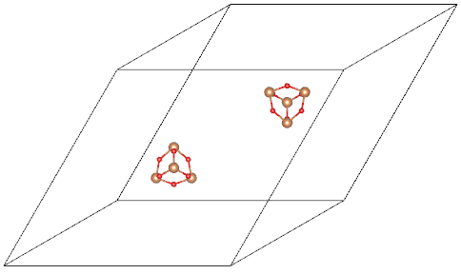
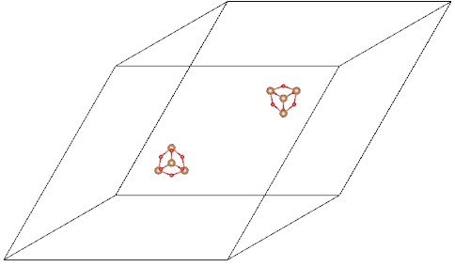
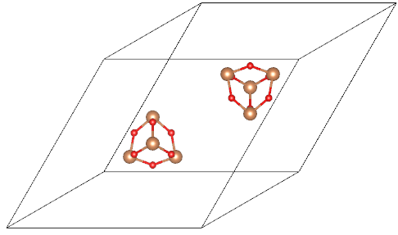
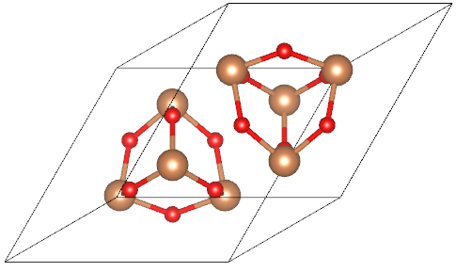
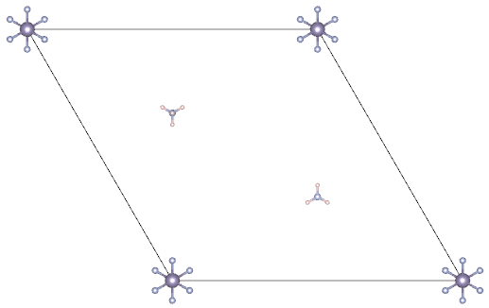
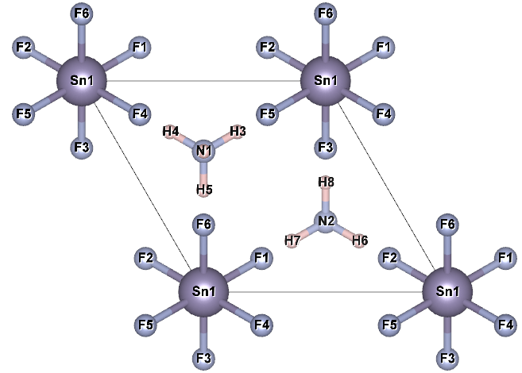
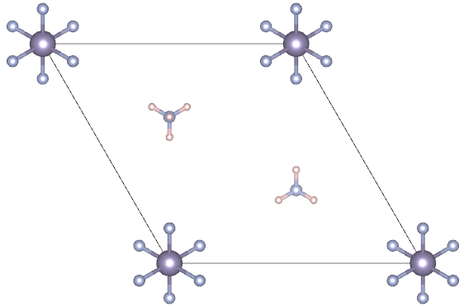
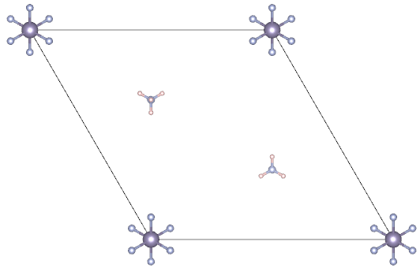
Interactions between constituent clusters
Idea: Increase the distance between constituent clusters & observe the total energy evolution
mp-1999_0D_Sb2O3_optB88: charge-neutral
Size: 1x1x1
Size: 2x2x2
Size: 3x3x3
Size: 4x4x4
mp-24113_0D_SnH8_lb_NF3_rb_2_optB88: (NH4)⁺ & (SnF6)²⁻
Size: 1x1x1
Size: 2x2x2
Size: 3x3x3
Size: 4x4x4

Slide 4
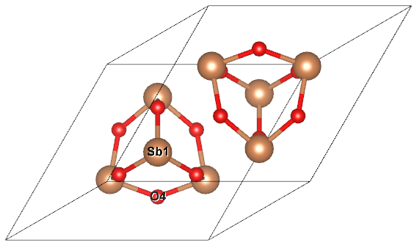
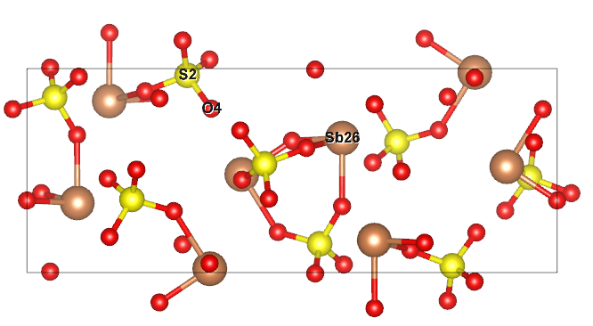
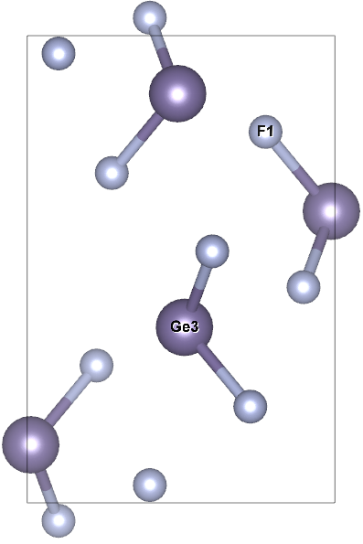
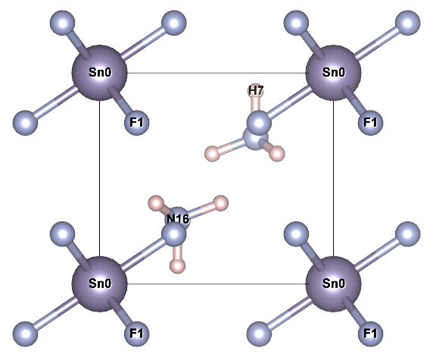
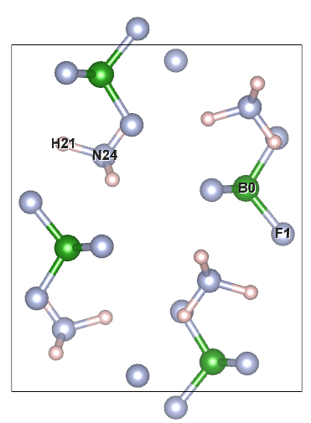
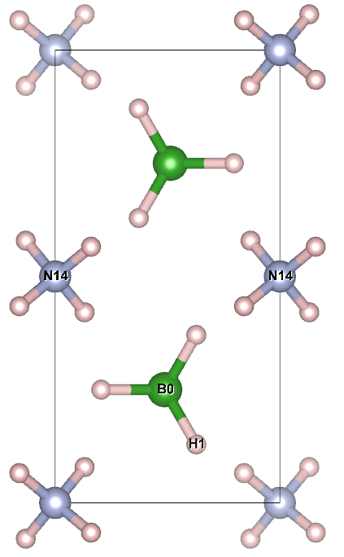
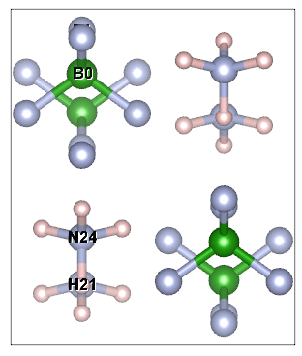
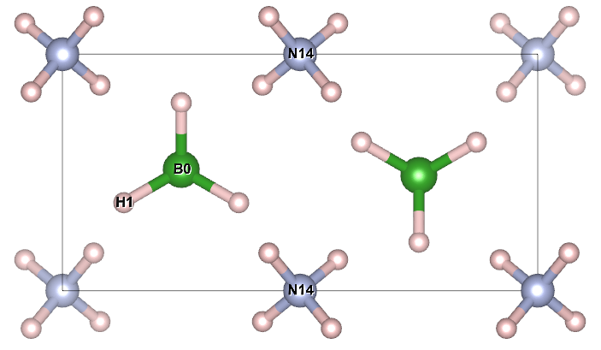
opt_mp-1999_0D_Sb2O3_optB88_latt_1_1_1
Ellipsoid vol: 30.266 * 2
opt_mp-638424_0D_Sb2S2O9_optB88_latt_1_1_1
Ellipsoid vol: 61.735 * 4
opt_mp-7595_0D_GeF2_optB88_latt_1_1_1
Ellipsoid vol: 4.370 * 4
All clusters are charge-neutral
All clusters are charged
opt_mp-24113_0D_SnH8_lb_NF3_rb_2_optB88_latt_1_1_1
Ellipsoid vol: 33.551, 1.759*2
opt_mp-720391_0D_BH4NF4_optB88_latt_1_1_1
Ellipsoid vol:
opt_mp-1190290_0D_BH8N_optB88_latt_1_1_1
Ellipsoid vol: 2.985 * 2, 1.809 * 2

Slide 5
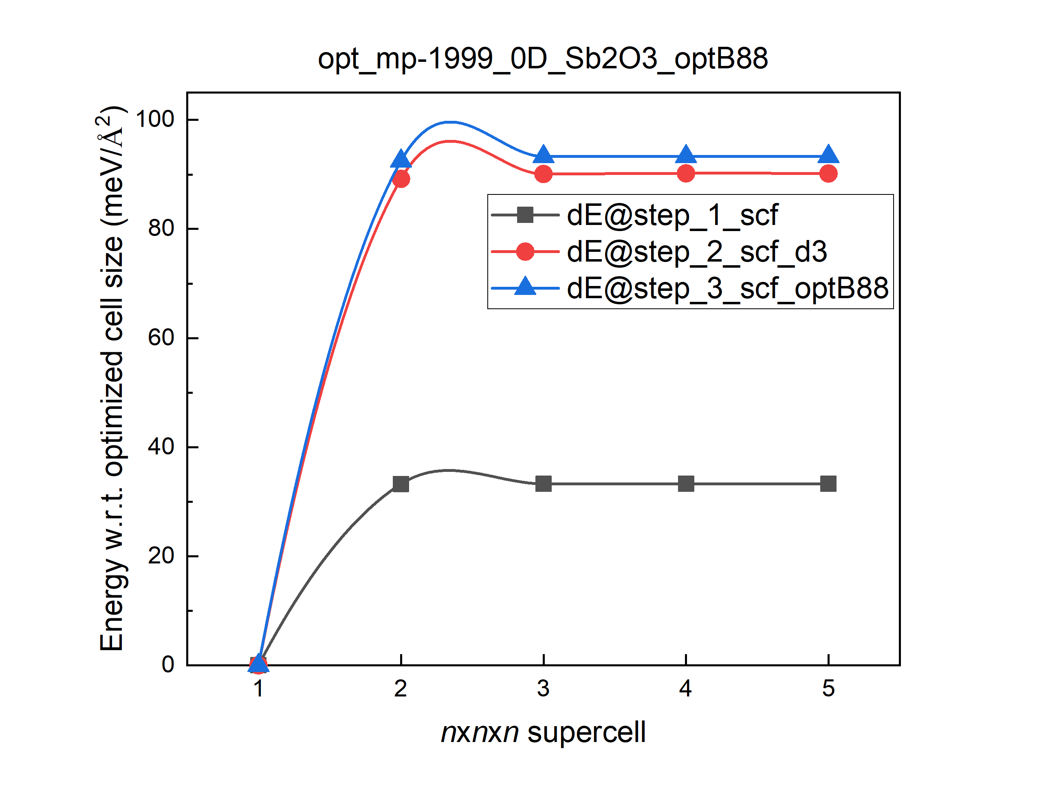
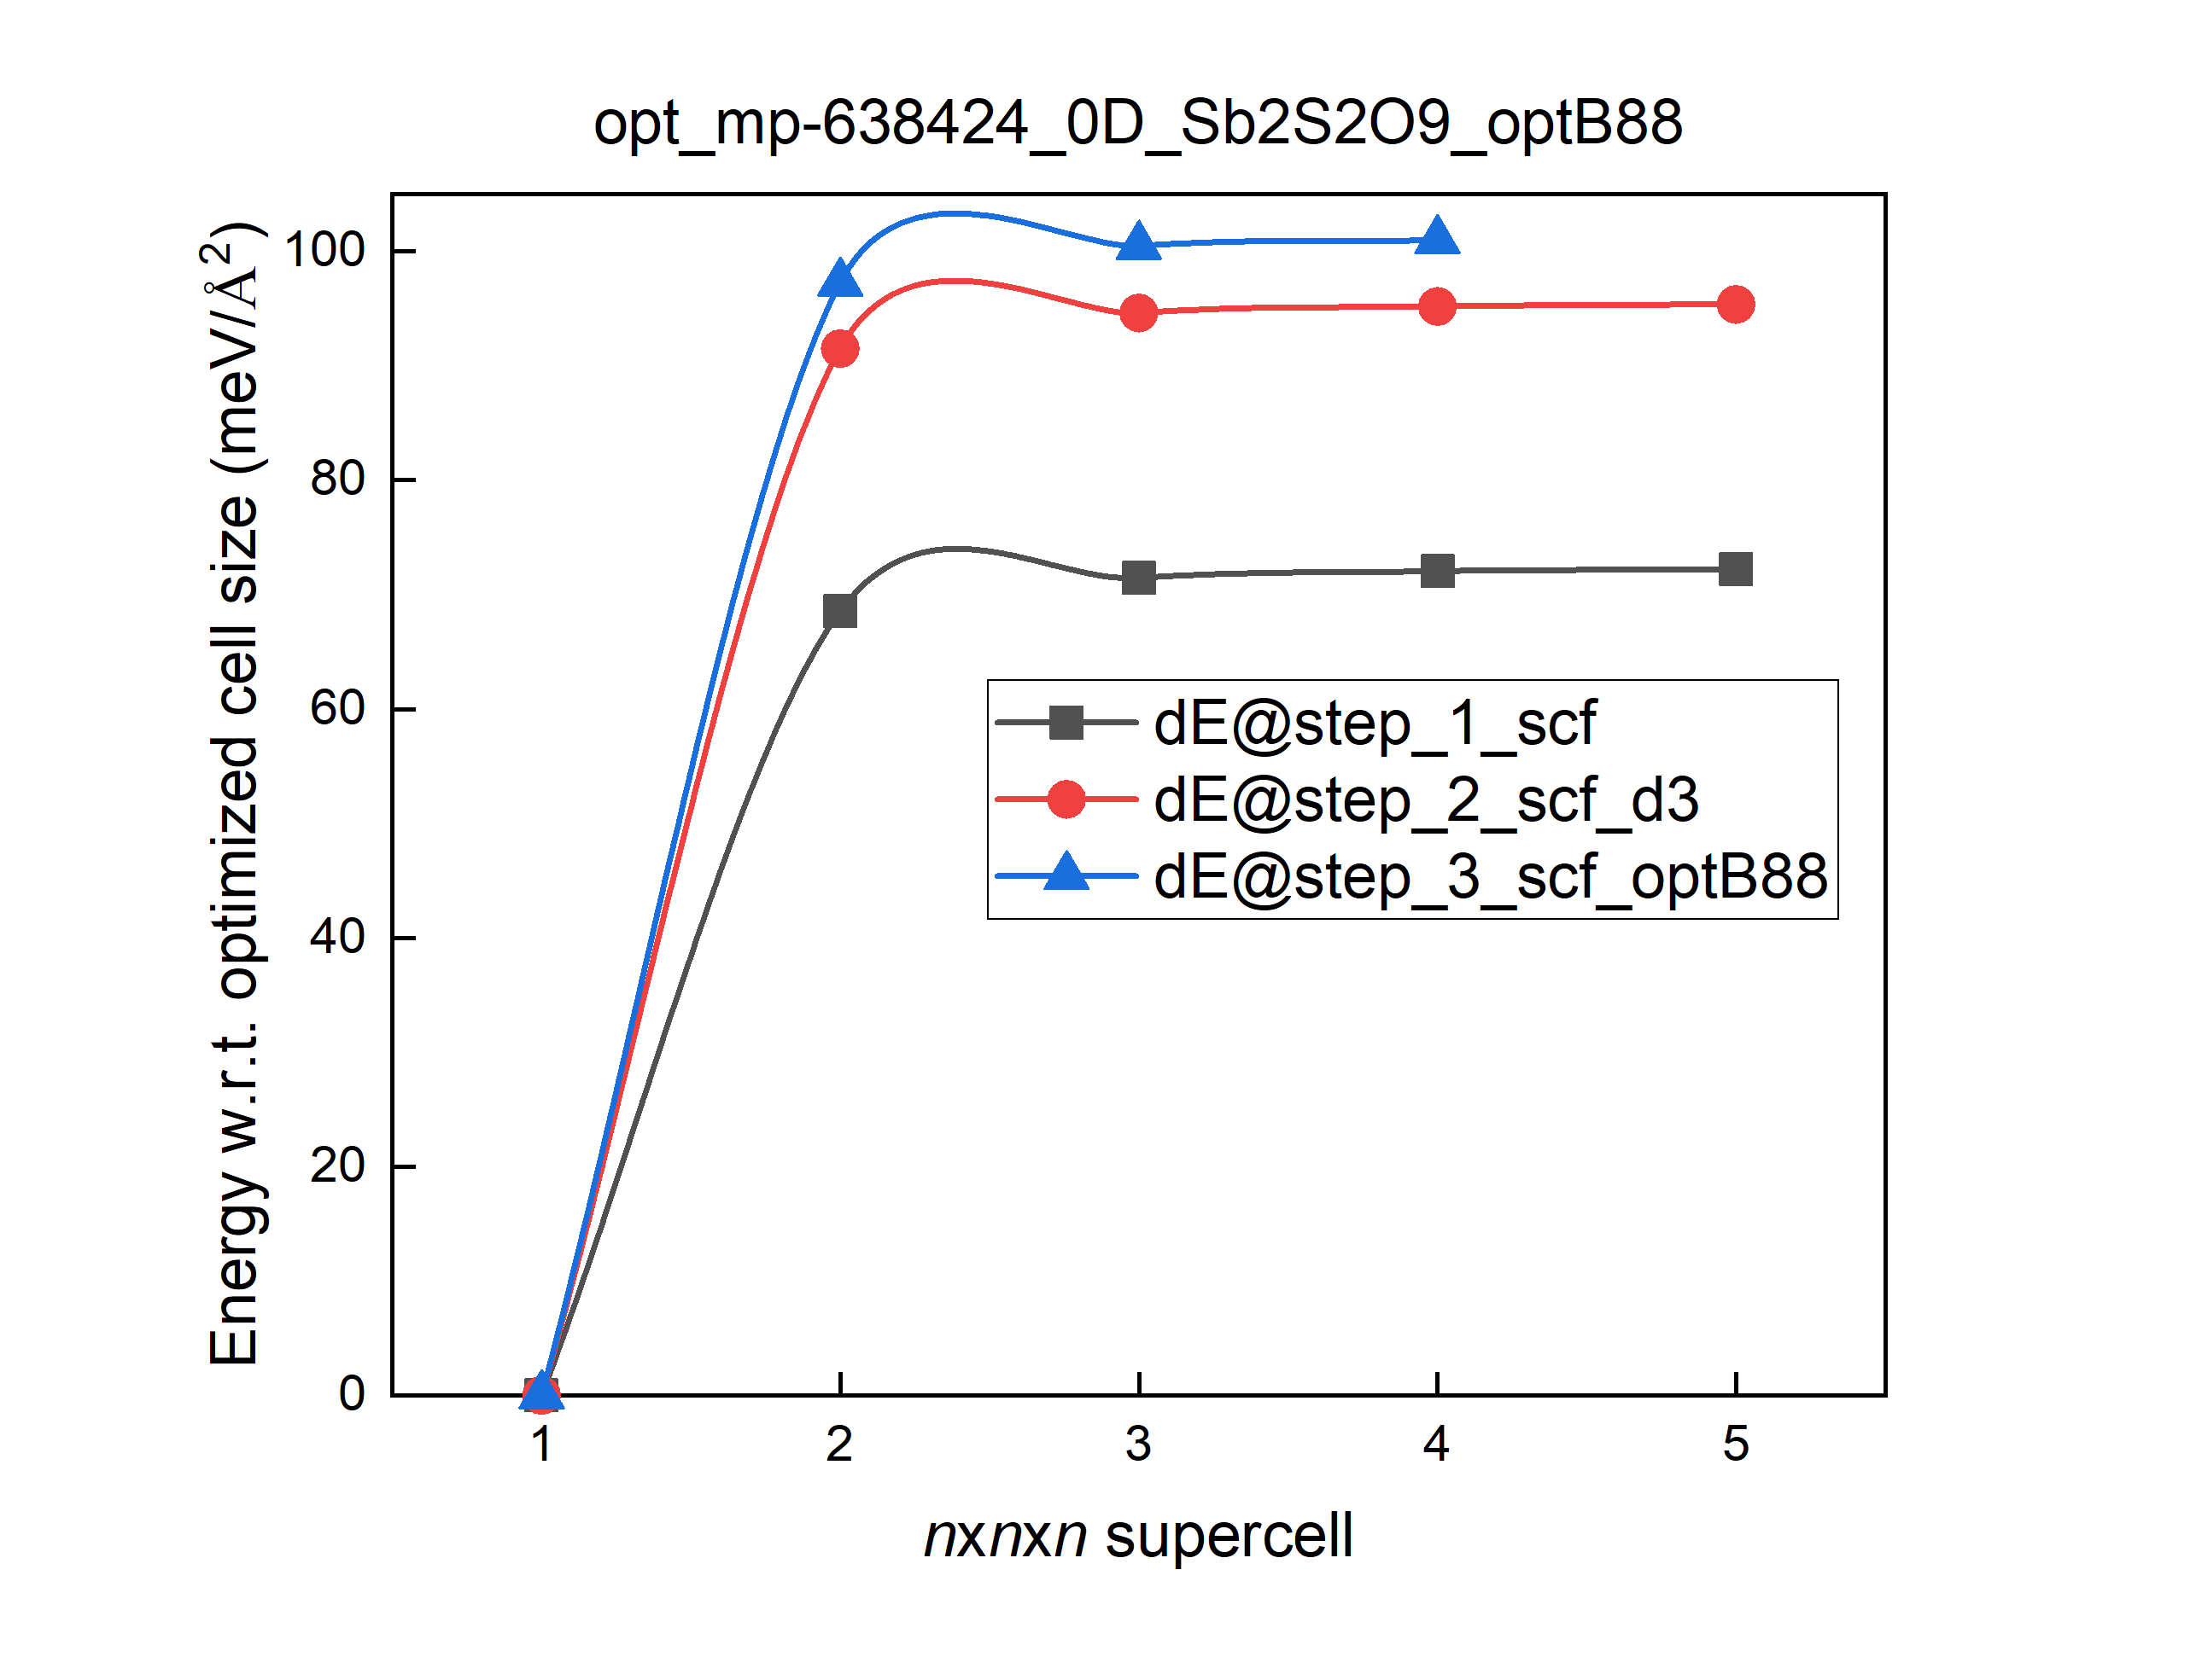
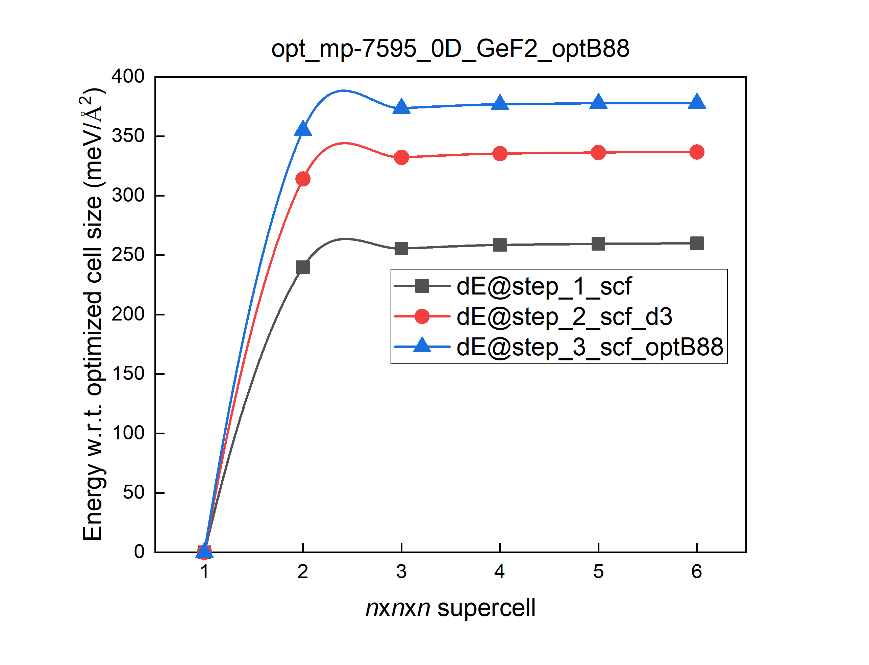
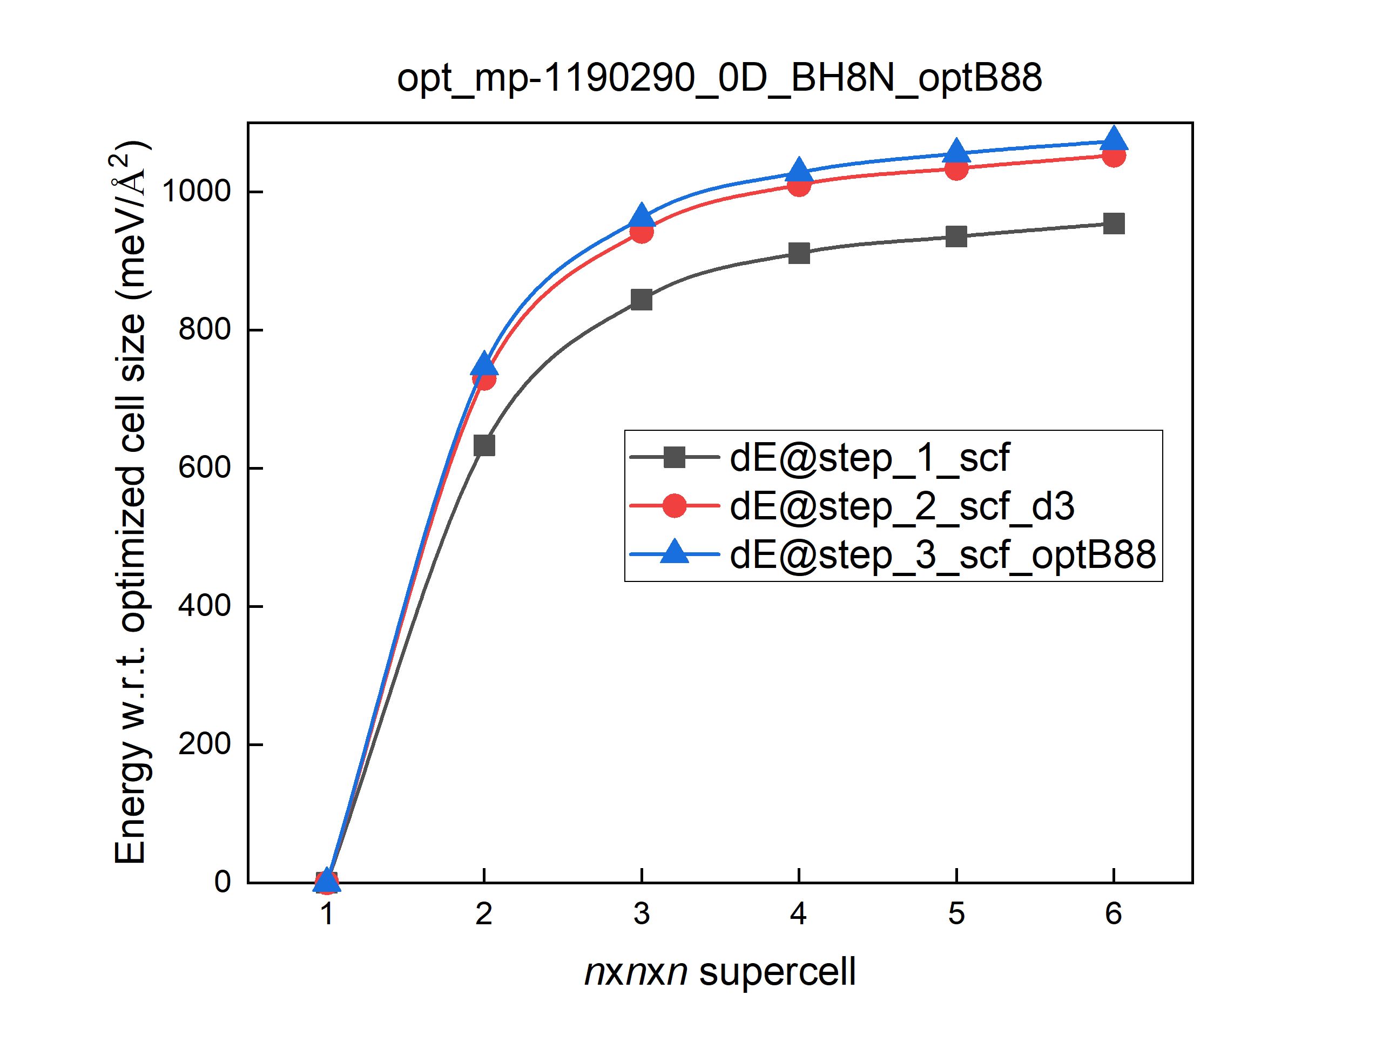
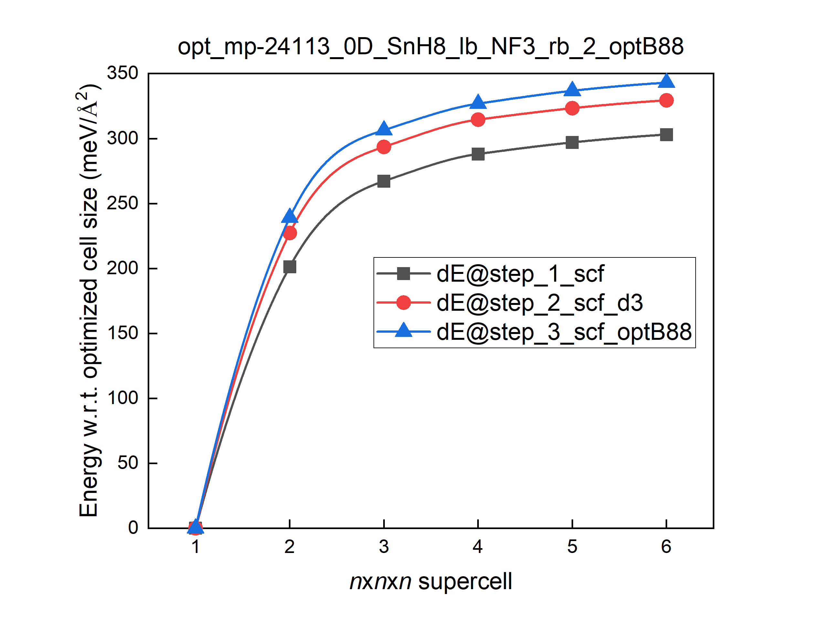
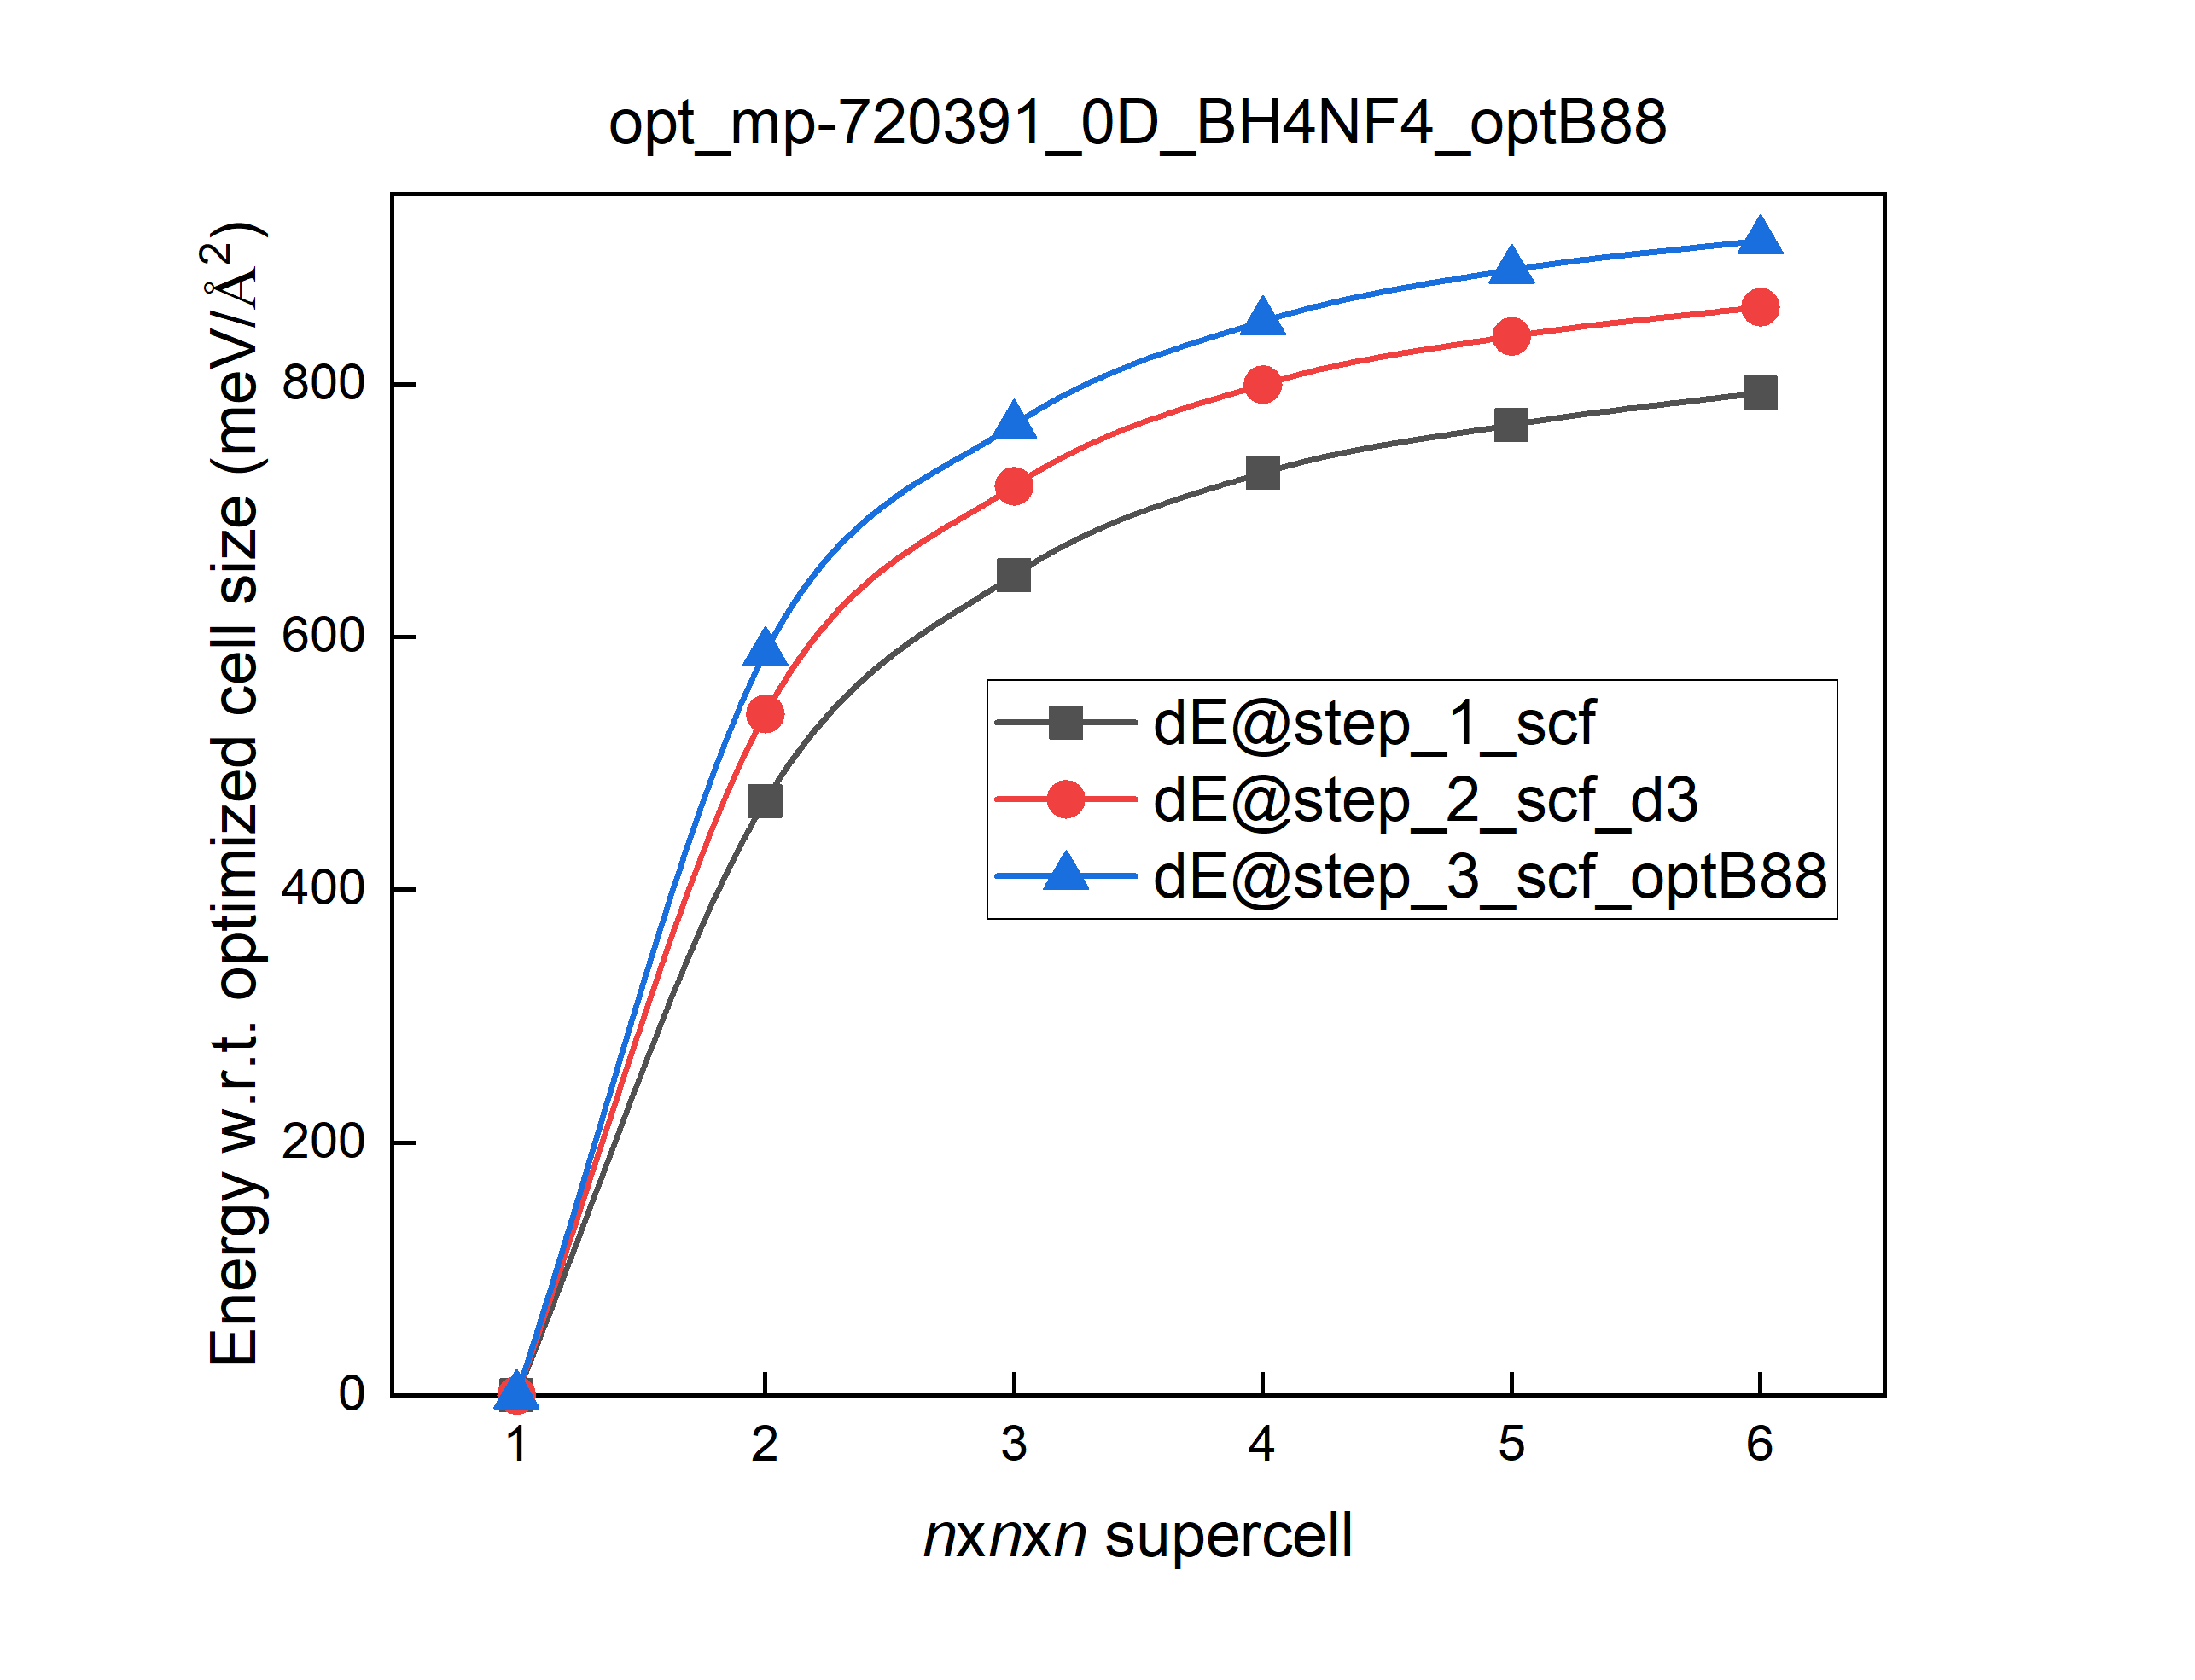

Slide 6
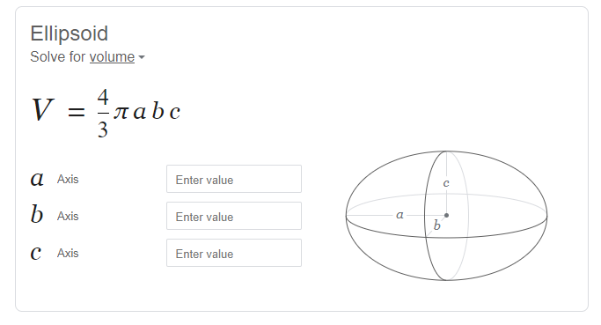
0D Materials – 1 task only
Task: define a surface that encloses a single constituent 0D cluster and calculate the surface area.
Requirement:
The approach should be general enough to handle various 0D clusters
Avoid brute-force exhaustive scanning of the whole 3D space
Balance the calculation complexity and the accuracy
Given a surface type (sphere, ellipsoid, or rectangular cuboid), try to minimize the enclosing volume.
Any surface type can be considered here. But we can work on sphere and ellipsoid, and take them as references.
opt_mp-1999_0D_Sb2O3_optB88_latt_1_1_1
Do rush to coding. Think about potential solutions and ensure the solutions are crystal clear first.

Slide 7
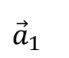
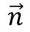
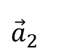
1D Materials – 1st task
Task I: find the direction of every constituent 1D chain in a given 1Dmaterial.
The potential solution as discussed:
Step 1: identify all constituent 1D chain(s) in its unit cell structure.
Step 2: select an atom in a constituent 1D chain, say the green site on the right plot
Step 3: build a 2x2x2 supercell and identify all constituent 1D chain(s).
Step 4: In the 2x2x2 supercell, every 1D chain have 2 green sites now. Their position must differ by a linear combination of the unit-cell lattice vectors. Use their fractional coordinates modulo 1 to pinpoint these two green sites. Their cartesian coordinate difference gives the direction of the 1D chain.
$$\vec{n}$$
$${\vec{a}}_{2}$$
$${\vec{a}}_{1}$$
Can be coded.

Slide 8
1D Materials – 2nd task
Task II: Are all 1D chains in a given material aligned in the same direction?
$$\vec{n}$$
$${\vec{a}}_{2}$$
$${\vec{a}}_{1}$$

Slide 9
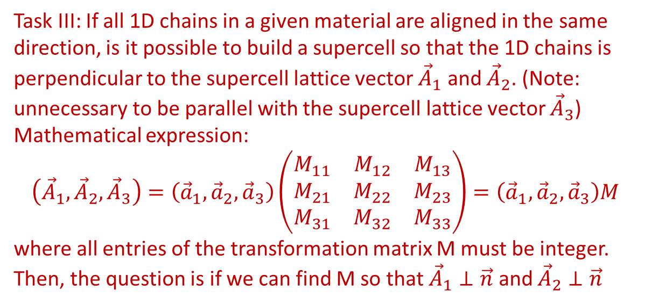
1D Materials – 3rd task
Task III: If all 1D chains in a given material are aligned in the same direction, is it possible to build a supercell so that the 1D chains is perpendicular to the supercell lattice vector ${\vec{A}}_{1}$ and ${\vec{A}}_{2}$. (Note: unnecessary to be parallel with the supercell lattice vector ${\vec{A}}_{3}$)
Mathematical expression:
$$\left({\vec{A}}_{1}, {\vec{A}}_{2},{\vec{A}}_{3}\right)=\left({\vec{a}}_{1},{\vec{a}}_{2},{\vec{a}}_{3}\right)\left(\begin{matrix}M_{11} & M_{12} & M_{13} \\ M_{21} & M_{22} & M_{23} \\ M_{31} & M_{32} & M_{33}\end{matrix}\right)=\left({\vec{a}}_{1},{\vec{a}}_{2},{\vec{a}}_{3}\right)M$$
where all entries of the transformation matrix M must be integer. Then, the question is if we can find M so that ${\vec{A}}_{1}⊥\vec{n}$ and ${\vec{A}}_{2}⊥\vec{n}$
$$\vec{n}$$
$${\vec{a}}_{2}$$
$${\vec{a}}_{1}$$
Do rush to coding. Derive the mathematical constraint on M first.

Slide 10
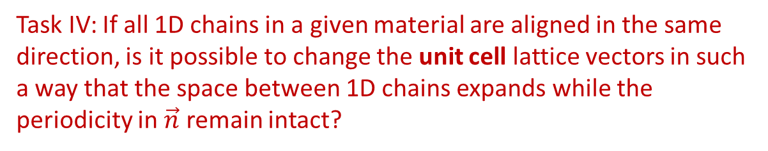
1D Materials – 4th task
Task IV: If all 1D chains in a given material are aligned in the same direction, is it possible to change the unit cell lattice vectors in such a way that the space between 1D chains expands while the periodicity in $\vec{n}$ remain intact?
$$\vec{n}$$
$${\vec{a}}_{2}$$
$${\vec{a}}_{1}$$
Do rush to coding. Do mathematics to check if this is possible.

